Slide 1


Slide 2
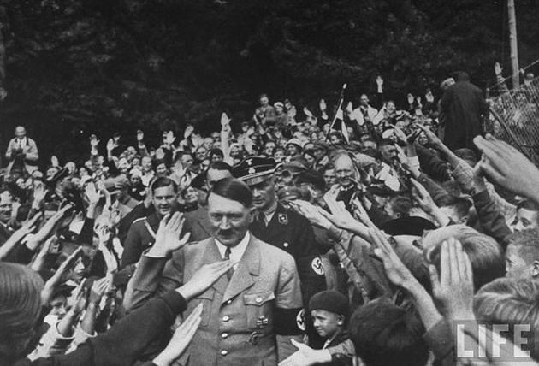
Nazi Germany 1918 - 1945

Slide 3
Nazi Germany
The Nazi rise to power brought an end to the Weimar Republic, a parliamentary democracy established in Germany after World War I.
Adolf Hitler was appointed as chancellor on January 30, 1933, the Nazi state (the Third Reich) quickly became a regime in which Germans enjoyed no guaranteed basic rights.
After a suspicious fire in the Reichstag, on February 28, 1933, the government issued a decree which suspended constitutional civil rights and created a state of emergency in which official decrees could be enacted without parliamentary confirmation.

Slide 4
Germany before world war one
Before WW1 Germany was imperialistic, militaristic and autocratic.
Prior to 1871 Germany had been a cluster of 25 German-speaking states, city-states and duchies.
The road to unification and statehood was long…
fuelled by a rise in German nationalism in the early 1800s (race, culture, language and power)
nationalists dreamed of a united Germany, its people infused with patriotism, its government manned by decisive leaders and its economy at the technological forefront of the world
At the forefront of this new Germany would be its army and navy (from its most powerful member-state: Prussia)
Notes:
Before WW1 Germany had struggled to assert its place in the world.
In 1914 Germany had been a unified state for less that half a century. Prior to 1871 Germany had been nothing more that a cluster of 25 German speaking states. Sandwiched between France, Russia and the North Sea.

Slide 5
German Unification
Industries and businesses grew rapidly
Population 65 million and one of the strongest armies in Europe
Germany quickly became one of the worlds great powers
Germany was not a democracy
Under the German constitution, the Kaiser (emperor) ruled Germany and chose his ministers
Political Parties
The Social Democrat Party, representing the workers, was the biggest party. During WW1 the party splits.

Slide 6
Reading: The Unification of Germany Complete reading paying particular attention to the key influences:
Bismarch
Economy
Prussian army
Nationalism and liberalism
Influence of other nations (particularly that of France and Austria)
Focus Questions after reading:
When (and why) did Germany become a nation?
What did Germany unification mean for people living in German territory?
Why did many Jews rejoice at German unification?

Slide 7
Germany during the war
1. Powerbrokers
Kaiser Wilhelm II -> ruler of Germany
The effective control of the war had shifted to the military high command:
Paul von Hindenburg -> came from Prussian aristocracy
Erich Ludendorff -> middle class background
2. Russian Revolution
Germany defeated Russia in 1917 leaving the country in revolution

Slide 8
Germany during the war cont.
3. United States of America
Germany introduced a naval policy of unrestricted submarine warfare. Any ship which sought the ports of Britain or France would be sunk.
In March 1917, a US merchant vessel was sunk and in April 1917 USA declare war on Germany.

Slide 9
Germany during the war cont.
4. Last Offensive
Ludendorff believed Germany’s only hope for victory lay in a breakthrough of the Western Front. Before US had enough time to fully get involved in the war.
May 1918 the German position looked very promising. They had forced allied lines back but not yet broken them.
Many Germans best troops died in the process. Had to draw from the German youth and elderly to replace them.
100 000 US troops joined the war, and anther 250 000 arriving each month.
July 1918, The western Allies pushed Germany back and the German defence line was broken by August.
Ludendorff and Hindenburg tell Kaiser Wilhelm II and Chancellor von Hertling that war is lost and Germany needs to negotiate an armistice.

Slide 10
Organising an armistice
Demands from the west
Only willing to negotiate if Germany undertake steps to become a democracy
German high command (Ludendorff, Hindenburg etc.) looked to shift responsibility to others – civilian politicians and political change
Prince Max von Baden is appointed as Chancellor

Slide 11
Stab in the back
Germany had been confidently assured victory
In reality…
Severe food shortages
“Stab in the back” was a belief deliberately encouraged by right-wing conservatives.

Slide 12
Reading: 1.1 – 1.2 Republic to Reich
Focus Questions after reading:
Under what circumstances did Kaiser Wilhelm II abdicate?
Who was Freidrich Ebert?
Why was the Spartacist uprising unsuccessful?

